Slide 1
Customer Segmentation Analysis

Slide 2
SCOPE
Whenever you need to find your best customer, customer segmentation is the ideal methodology. We will perform one of the most essential applications of machine learning – Customer Segmentation. In this project, customer segmentation is implemented in R.

Slide 3
What is Customer Segment analysis?
Customer segmentation is the process by which you divide your customers up based on common characteristics – such as demographics or behaviors, so you can market to those customers more effectively.

Slide 4
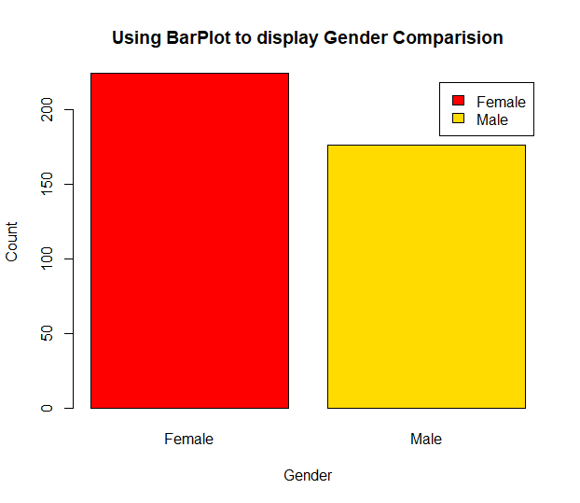
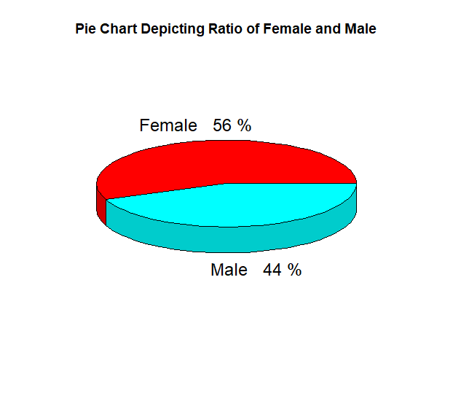
Customer Gender Comparison

Slide 5
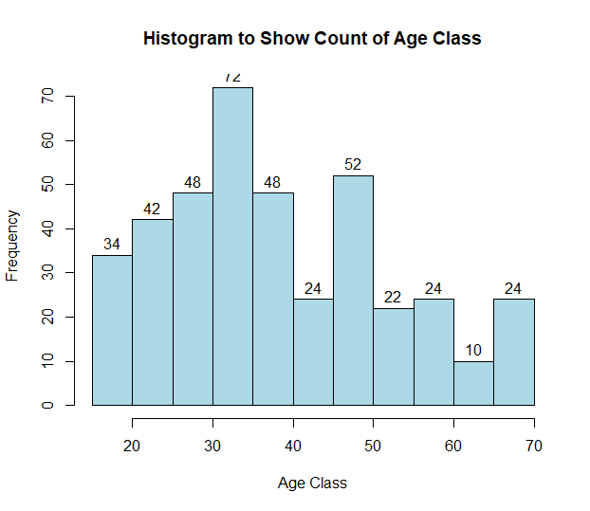
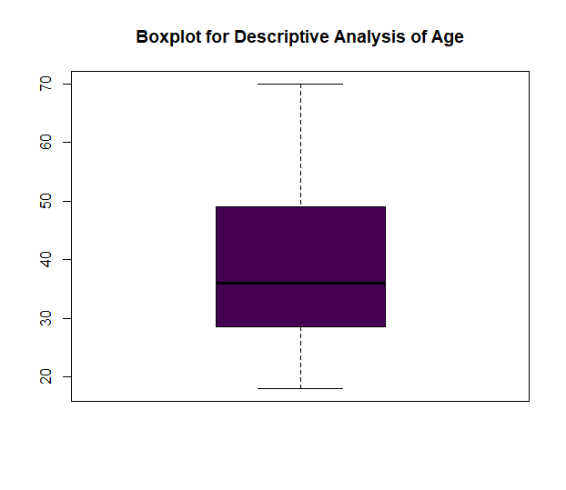
Customer Age Distribution

Slide 6
Customer Age Distribution
From the above visualizations, I conclude that the maximum ages of the customers are between 30 and 35.
The minimum age of customers is 18, whereas the maximum age is 70.

Slide 7
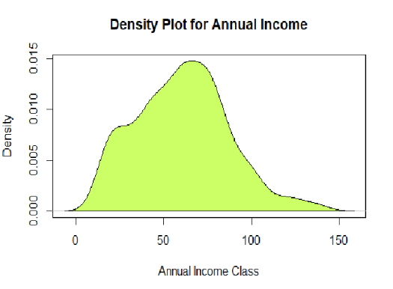
Analysis of Annual Income of Customers

Slide 8
Analysis of Annual Income of Customers
From the above analysis, I conclude that the minimum annual income of the customers is 15 and the maximum income is 137.
The average salary of all the customers is 60.56.

Slide 9
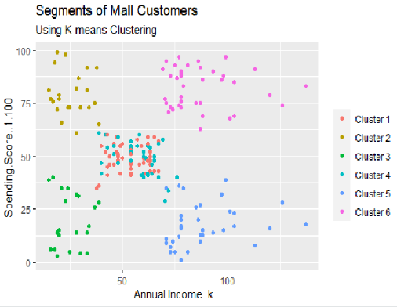
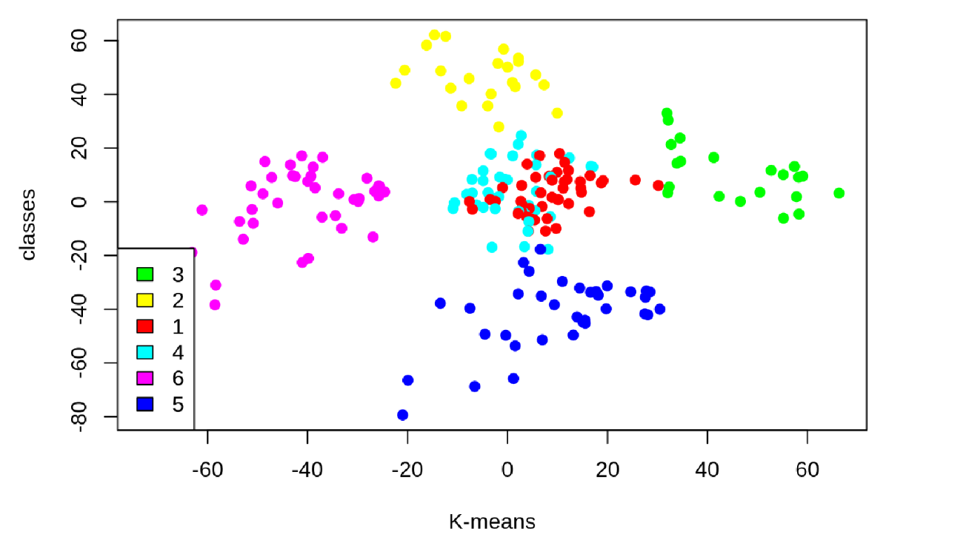
K-means algorithm

Slide 10
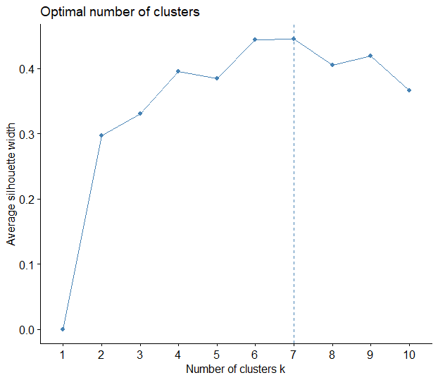
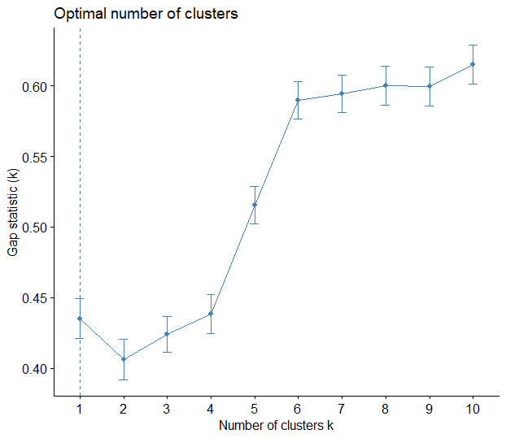
Additional Visualizations

Slide 11
Conclusion
In this project, we went through the customer segmentation model.
The model is developed by using unsupervised learning, specifically with a clustering algorithm called K-means clustering.
Different types of visualizations are used to analyse the dataset in R.

